Slide 1
ONLINE BOOKMARKING APPLICATION
Software Engineering Project – Review 1

Slide 2
INTRODUCTION
Objective:
To develop an online bookmarking application with which users can save, manage, organize and access their bookmarks from virtually any internet enabled computer device, be it mobile/laptop/tablet.

Slide 3
Problem Statement
With the ever increasing number of websites and use of internet for numerous things, bookmarking important websites have significantly grown. But the present system has limited functionality, one cannot access their saved bookmarks from different computer. Our application will directly address this problem and provide mechanism to organize bookmarks, effectively manage them and the ability to access them from multiple devices.

Slide 4
Background Information
As we know that bookmarking webpages is a need of many. With increasing number of multipurpose computer devices, one need to access their bookmarks from multiple devices. The problem is, one cannot access the bookmarks saved on one device or one web browser on other. The target users here are all the people using internet who use bookmarks to save links and URL.
Their exist number of systems for saving bookmarks but none are similar to ours. The existing bookmarking systems are: the web browser integrated bookmarking systems which are available in all major web browsers such as Google Chrome, Mozilla Firefox, Internet Explorer, Opera, Safari, etc.

Slide 5
Project Objectives
Online user account: The application will have user accounts for each of its user, where one registers with the application to get their account.
Online bookmarks storage: The bookmarks will be stored online instead of local hard drives in the user accounts.
Bookmarks classification and categorization: Bookmarks can be classified and organized by the user as they want.
Quick Link Tabs: This will categorise main bookmarks separately for fast and easy access.
User Interface: All of the process of user registration, bookmark classification will be done on a user interface.

Slide 6
Feasibility Study
Through online research we found that there doesn’t already exist such a feasible system, this gives the application a complete leverage over the market. And millions of people use bookmarks which gives us big market.
The project execution plan is properly designed considering number of factors in account. Also we have taken additional time frame just in case of unexpected delays.
The application will be quite feasible technically, because it will be an online application which means it just need browser and internet connection to run, it does not depend much on the user system. Operation does not involve much other than timely upgrades.

Slide 7
Process Model
Incremental Model:
Rather than delivering the system as a one time delivery, the development and delivery is broken down into increments with each increment delivering part of the required functionality.
The reason we chose incremental model:
So that we can develop the system in Increments.
By developing system in increments we will be able to evaluate each increment before proceeding to the development of the next increment.
By this we can assign each of the member with work in increments wise.

Slide 8
Deliverables
Online bookmarks storage.
User account to manage and store bookmarks.
Bookmarks classification and organization.
Accessibility from multiple computers enabled with browser and internet.

Slide 9
Stakeholders
Project Development and Design Team
Customers/Users

Slide 10
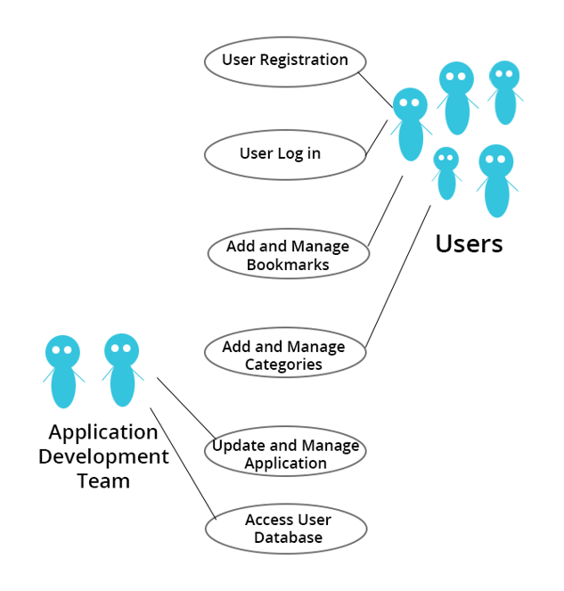
Use Case Diagram

Slide 11
Requirements
Functional Requirement
Register
Log in
Add New Bookmark
Bookmark Current Page
New Category
Manage Category
Manage Bookmarks
User Account

Slide 12
Non Functional Requirements
Accessibility: Anyone can use the application, there is no restriction to any person. The application can be accessed from the following internet enabled browsers: Google Chrome, Mozilla Firefox and Internet Explorer (Version 8 and above). And minimum system specification required are: 500MB RAM, Core2Duo or higher processor.
Security: The application will be hosted on safe and secure cloud servers. All the registration information of the users will be safe and secure and will not be shared with any third party and the email will not be spammed.

Slide 13
Non Functional Requirements
Failure Management: In case of any disaster or unexpected failure the user’s data will not be compromised because it will be stored on reliable servers. And the application will be up and running within 1 hour in case of unexpected failure.
Price: The application is free to use. No charges of any kind to use the application will be collected.
Response time: The response time of the application will depend on the bandwidth of the internet at which the user is accessing the application. However the minimum time to load the application from our server side will be not more than 1.5 sec.

Slide 14
Non Functional Requirements
Usability: It will be extremely easy to use the application. It would take about 3 minutes to get to know all the features of application and how to use it. The new user registration will take 30 seconds.
Scalability: The application will be designed keeping in mind the population using the internet and so there will be real time monitoring of number of users registering for it and the extra window will be implemented. Also since the application will be hosted on cloud based servers, they can be unscaled anytime according to requirement.

